Slide 1
Pre-Project Presentation
Development of decentralized blockchain system for community funding
Programme: B. Tech in CSE
Mentor : Mr. Hari Krishna S. M.
Group No. : Group XX
Team Leader : Subhendu Maji
Department : Computer Science

Slide 2
Project Team
Sl no. | Registration no. | Students
1. | 18ETCS002104 | Sahil Salim
2. | 18ETCS002121 | Subhendu Maji
3. | 18ETCS002131 | Tanishq R Porwar

Slide 3
Outline
Title and Aim
Objectives
Methods and Methodology ( or Block Diagram)
Status of the Work
Expected Outcomes
Cost Estimation
Gantt Chart
References

Slide 4
Title
Development of decentralised blockchain system for community funding.
Aim
To create a truly serverless, trustless, and transparent system to facilitate community funding.

Slide 5
Objectives
To conduct a literature survey on the existing community funding platforms.
To acquire functional and nonfunctional requirements based on the literature survey.
To gain insight on Ethereum framework, solidity programming and web3.js framework.
To develop smart contract based on the identified functional requirements.
To develop and deploy a web3 application for facilitate user interaction.
To deploy smart contract on Ethereum Blockchain.
To document the report consolidating all relevant results.

Slide 6
Methods and Methodology
To conduct a literature survey on the existing community funding platforms.
To review the literature on existing community funding platforms, their working, functionality and software used from peer reviewed journals, reference books and other authentic sources.
Identify the drawbacks in already existing systems and attempt to improve the system.

Slide 7
Methods and Methodology
2. To acquire functional and nonfunctional requirements based on
the literature survey.
2.1 On conducting literature survey, the functional and nonfunctional requirements are obtained.
2.2 Based on the identified requirements, a high level design will be created in UML.

Slide 8
Methods and Methodology
3. To gain insight on Ethereum framework, solidity programming and web3.js framework.
3.1 Understand Ethereum blockchain ecosystem
3.2 Learn Solidity programming language to create smart
contracts.
3.3 Get familiar with web3.js framework to establish a
communication between smart contract and the frontend.

Slide 9
Methods and Methodology
4. To develop smart contract based on the identified functional requirements.
4.1 Identify the different terms of contracts for the FRs.
4.2 To create the algorithm/pseudo code.
4.3 To implement smart contract using Solidity programming language.

Slide 10
Methods and Methodology
5. To develop and deploy a web3 application for facilitate user interaction.
5.1 Design a User friendly frontend.
5.2 Develop a ReactJS application.
5.3 Make use of web3.js library to communicate with smart contract

Slide 11
Methods and Methodology
6. To deploy smart contract on Ethereum Blockchain.
6.1 Deploy the smart contract to Ethereum Rinkeby Test Network for the frontend to interact.
7. To document the report consolidating all relevant results.
7.1 Develop a detailed scientific project report as per the template specified.
7.2 Demonstrate the working prototype of the community funding Dapp.

Slide 12
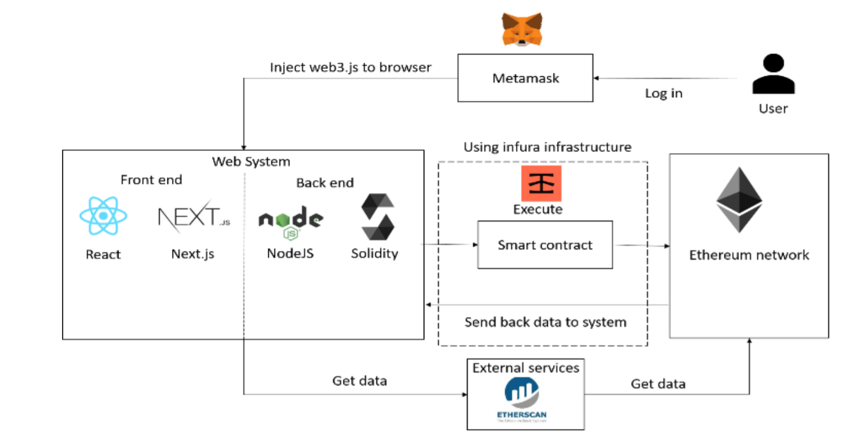
Block Diagram

Slide 13
Status of the Work
Literature review on existing community funding platforms, their working, functionality and software used from peer reviewed journals, reference books and other authentic sources is being performed.
Our project is focused on implementing a decentralized community funding platform.
Community funding is a financing method that involves funding a project with relatively modest contributions from a large group of individuals, rather than seeking substantial sums from a small number of investors.

Slide 14
Status of the Work Contd…
In blockchain, decentralization refers to the transfer of control and decision-making from a centralized entity to a distributed network.
Decentralized networks strive to reduce the level of trust that participants must place in one another, and deter their ability to exert authority or control over one another in ways that degrade the functionality of the network.
Smart contracts are simply programs stored on a blockchain that run when predetermined conditions are met.

Slide 15
Expected Outcomes
Successfully deployment of smart contract on the Ethereum Rinkeby Network.
Demonstration of working prototype of a community funding Dapp.

Slide 16
Cost Estimation
S.No. | Particulars/Components/Devices | Estimated Cost
1
2
 | Total:
Man hours:
Man hours per week (students): 18 *4 students =72
Man hours per week (faculty): 3

Slide 17
Gantt Chart
Project Work (UG) 16 weeks
Week | 1 | 2 | 3 | 4 | 5 | 6 | 7 | 8 | 9 | 10 | 11 | 12 | 13 | 14 | 15 | 16
Major Activities
1.1
1.2
2.1
2.2
3.1
3.2
3.3
4.1
4.2
4.3
5.1
5.2
5.3
6.1
7.1
7.2

Slide 18
References
Alharby et al., “Blockchain Based Smart Contracts: A Systematic Mapping Study”, 2017, 125-140. 10.5121/csit.2017.71011.
https://ethereum.org/en/developers/docs/
https://aws.amazon.com/blockchain/decentralization-in-blockchain/

Slide 19
Thank You

